Slide 1
Decision Tree Pruning

Slide 2
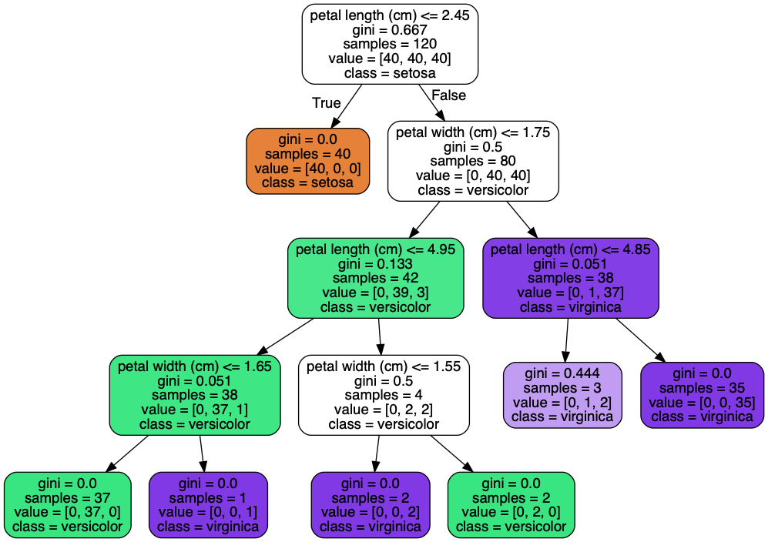
Pruning
Regularization technique for decision trees
Control growth of trees by reducing number of leafs
Notes:
Photo: https://www.flickr.com/photos/107442568@N08/12547327134

Slide 3
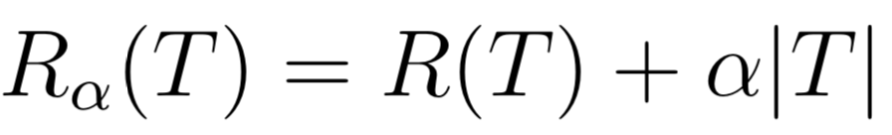
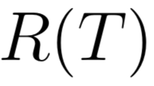
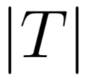

Pruning
Minimal cost complexity pruning, minimize: total misclassification rate in the tree total number of leaf nodes in the tree pruning complexity parameter
Notes:
Photo: https://www.flickr.com/photos/107442568@N08/12547327134

